Slide 1


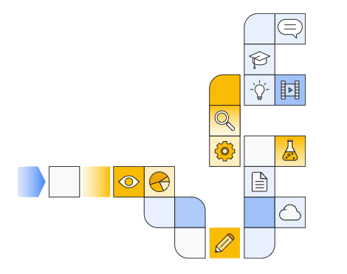

Notes:
https://www.cloudskillsboost.google/paths/183/course_templates/542/

Slide 2
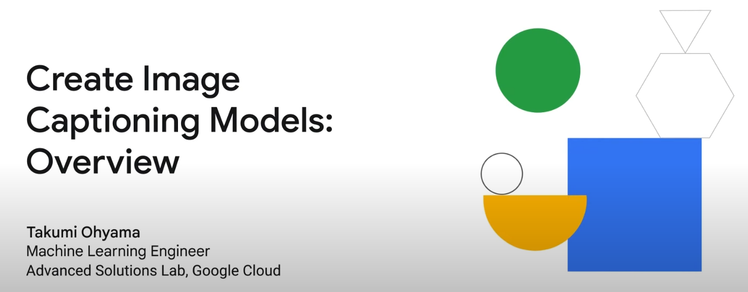

Two videos to watch?
Notes:
https://www.youtube.com/watch?v=7a5SMSCzTg8 (old)
https://www.youtube.com/watch?v=0BaIeMoFEoE (new)

Slide 3
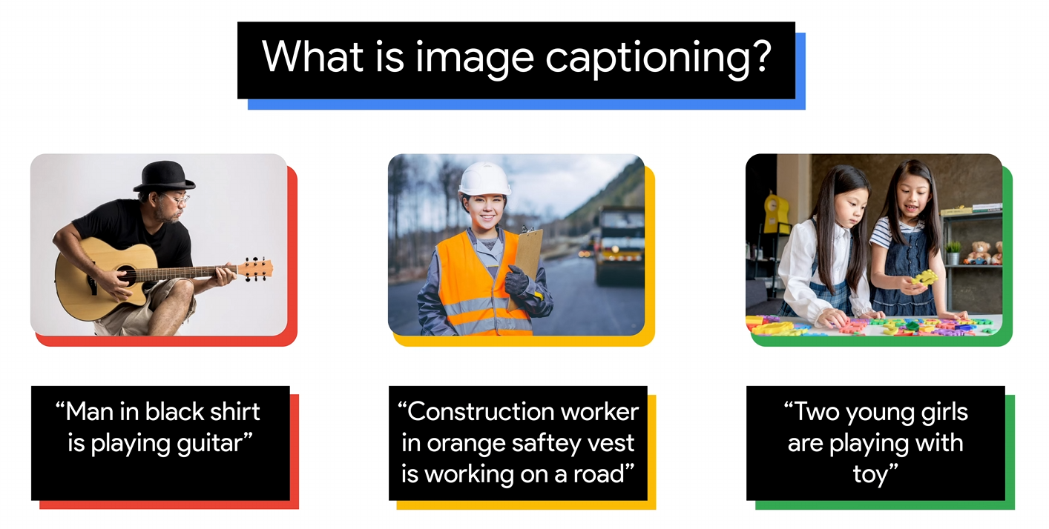

Slide 4
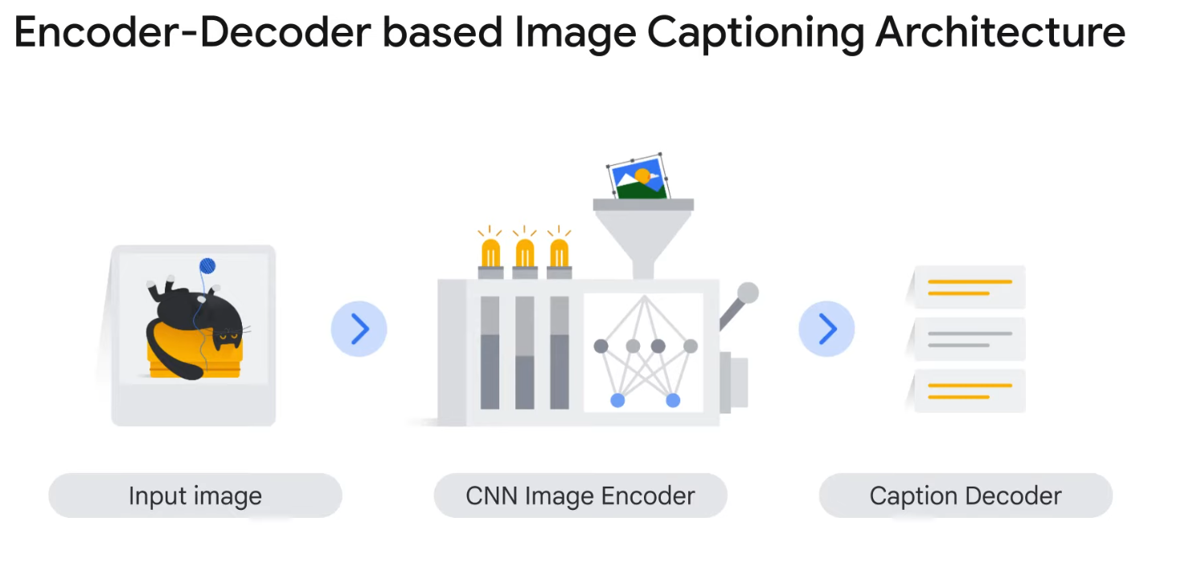

Slide 5
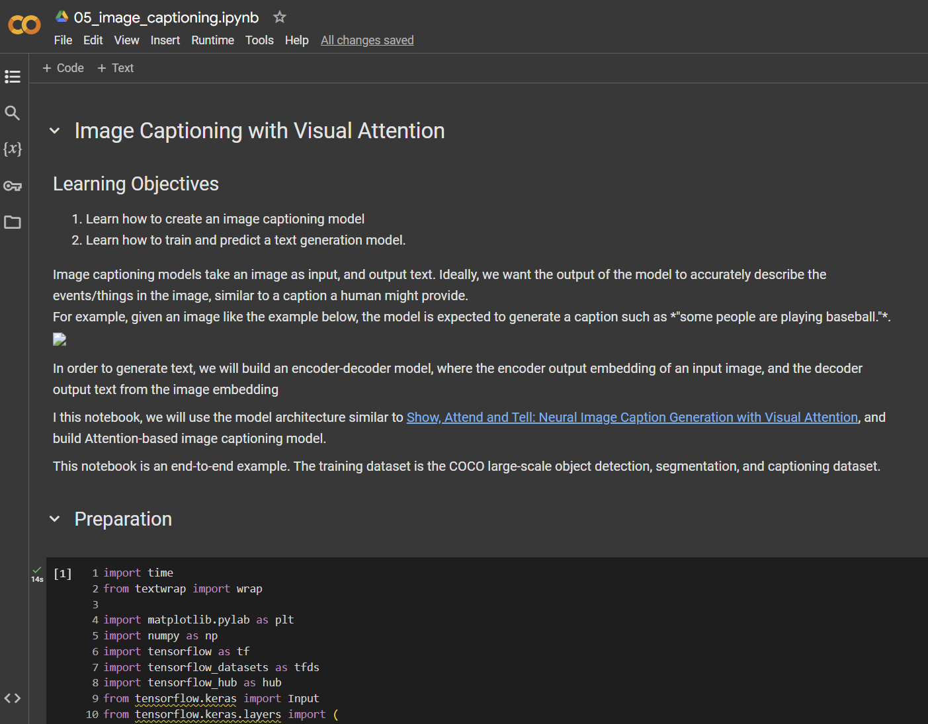

Slide 6
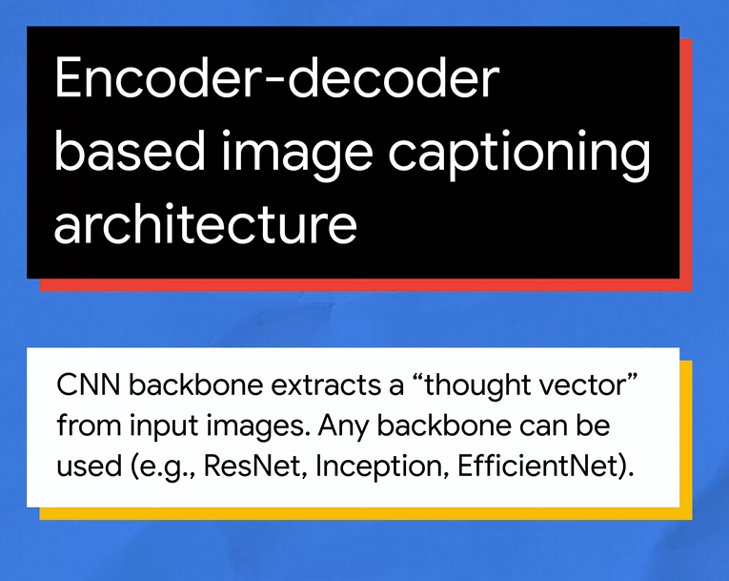

Slide 7
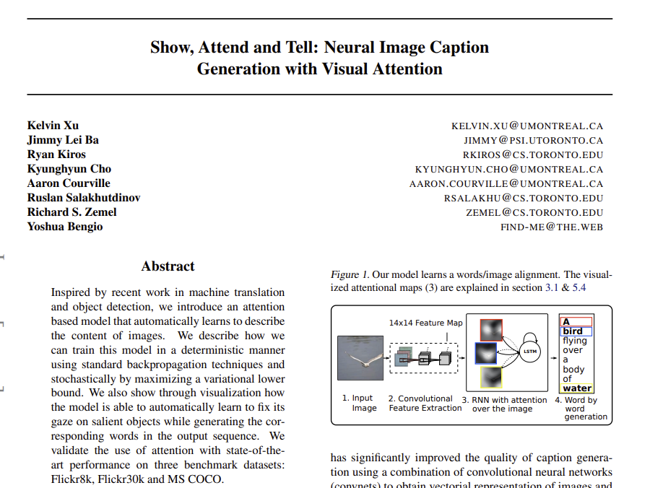
Notes:
https://arxiv.org/pdf/1502.03044

Slide 8
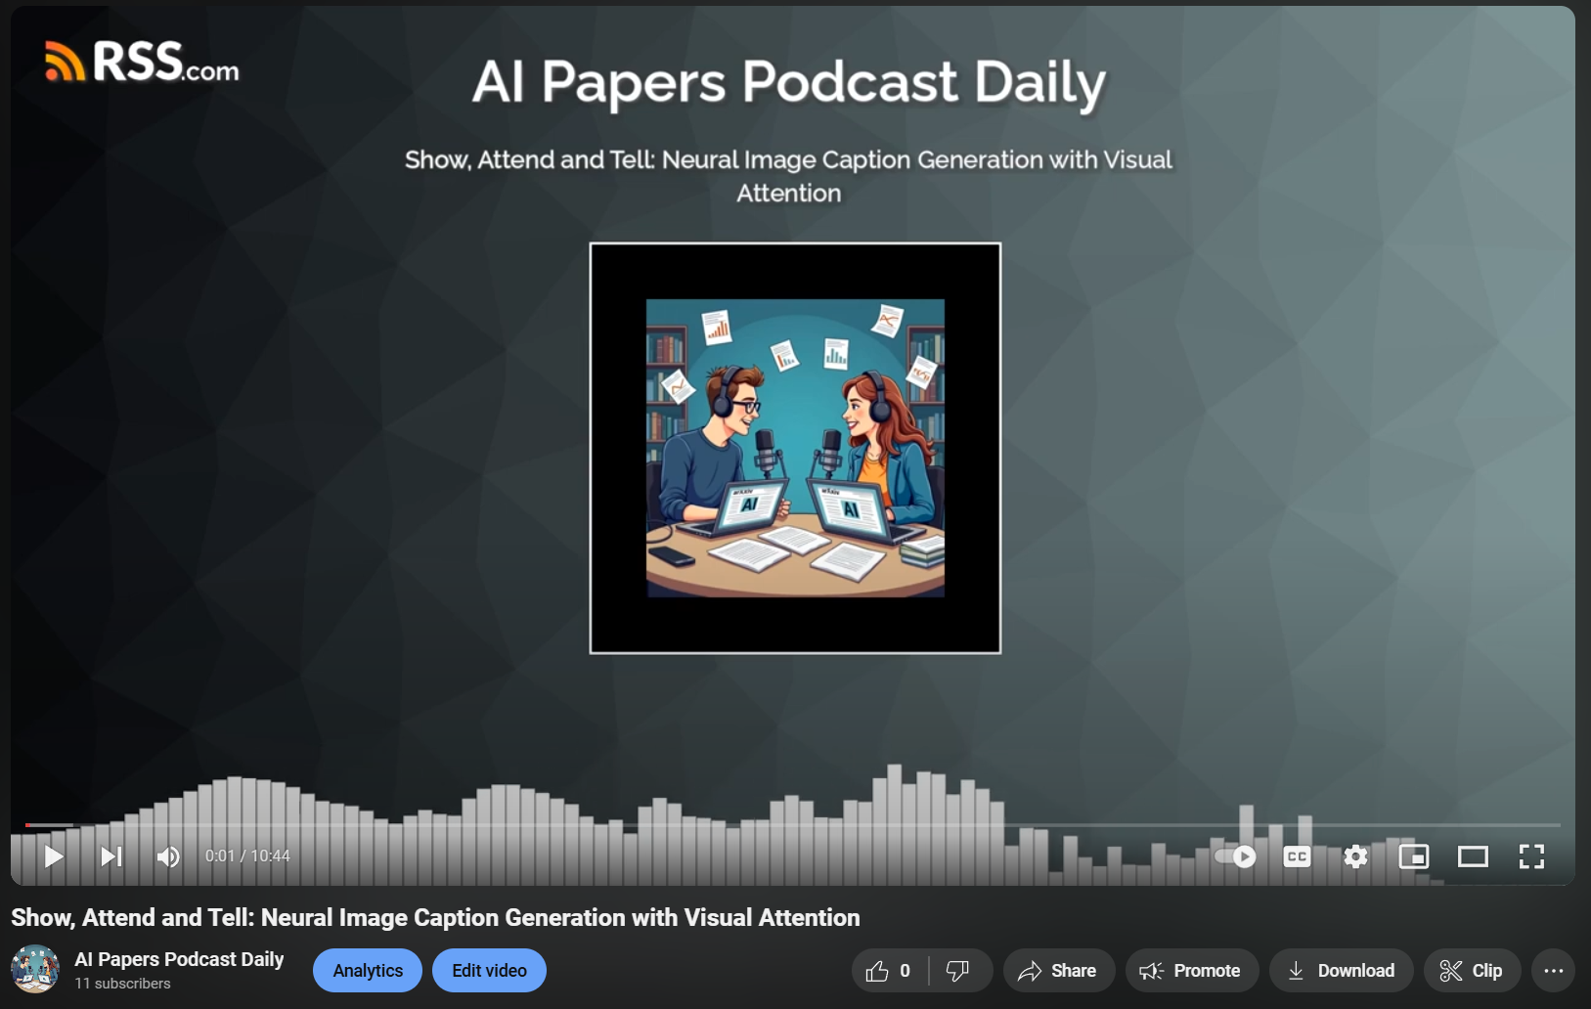
Notes:
https://www.youtube.com/watch?v=VGxk4ebXRaI

Slide 9
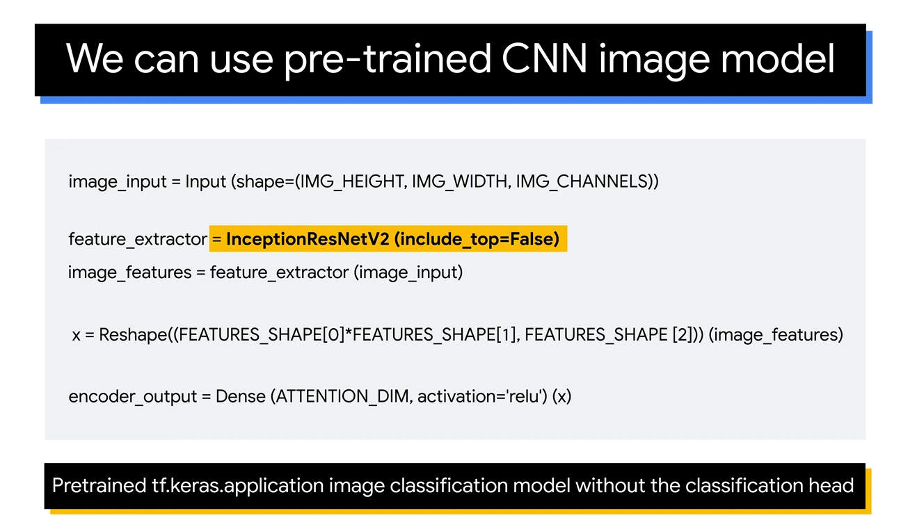

Slide 10
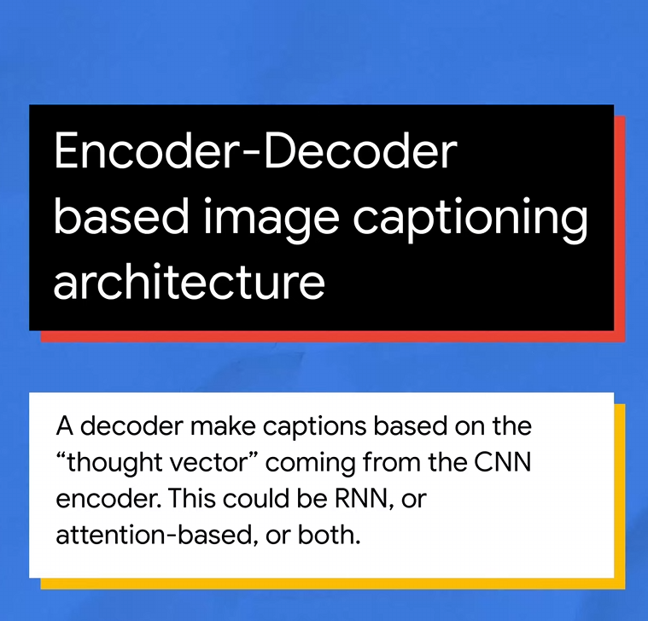

Slide 11
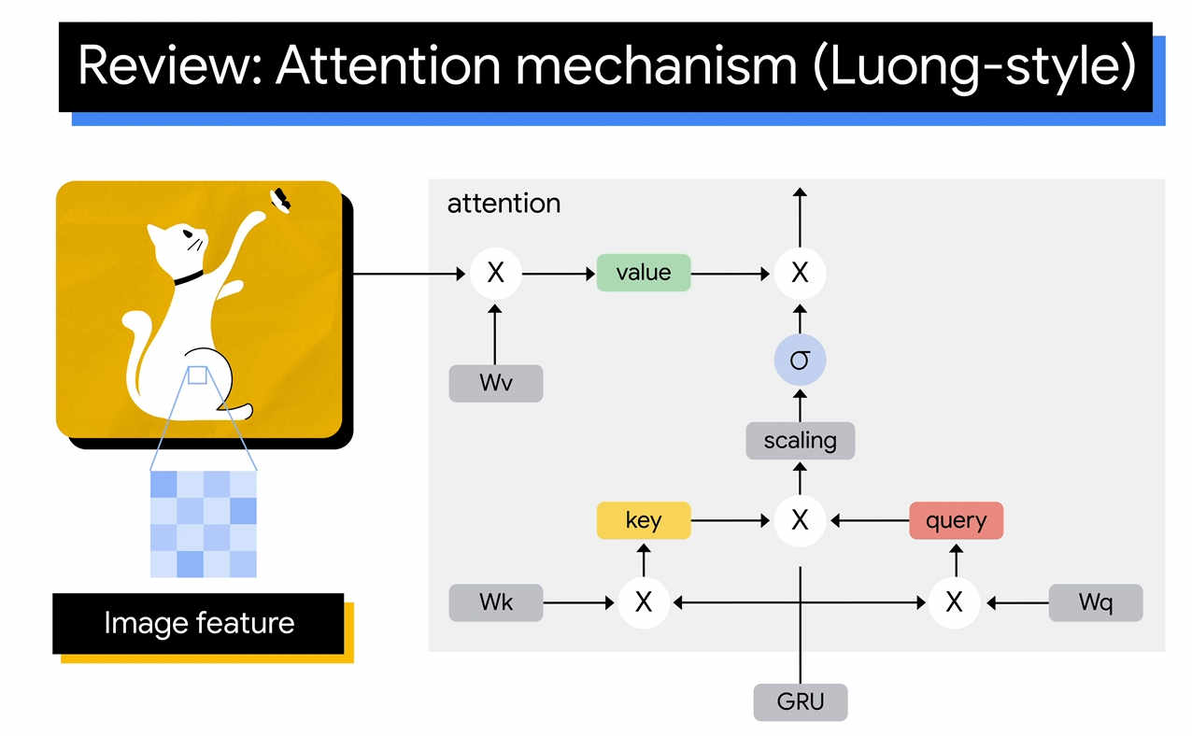
Attention Mechanism in Decoder
Softmax
Value Weight Matrix
Key Weight Matrix
Query Weight Matrix
Encoding
Gated Recurrent Unit
Notes:
Query (Q): Represents the current state or context of the model. In machine translation, for example, this might be the decoder’s hidden state at a particular time step.
Key (K): Represents different parts of the input sequence or feature (e.g., each word in a sentence or each region in an image).
Value (V): Represents the information carried by each key, which the model will use to make predictions. Values are weighted based on the alignment between the query and the keys.

Slide 12
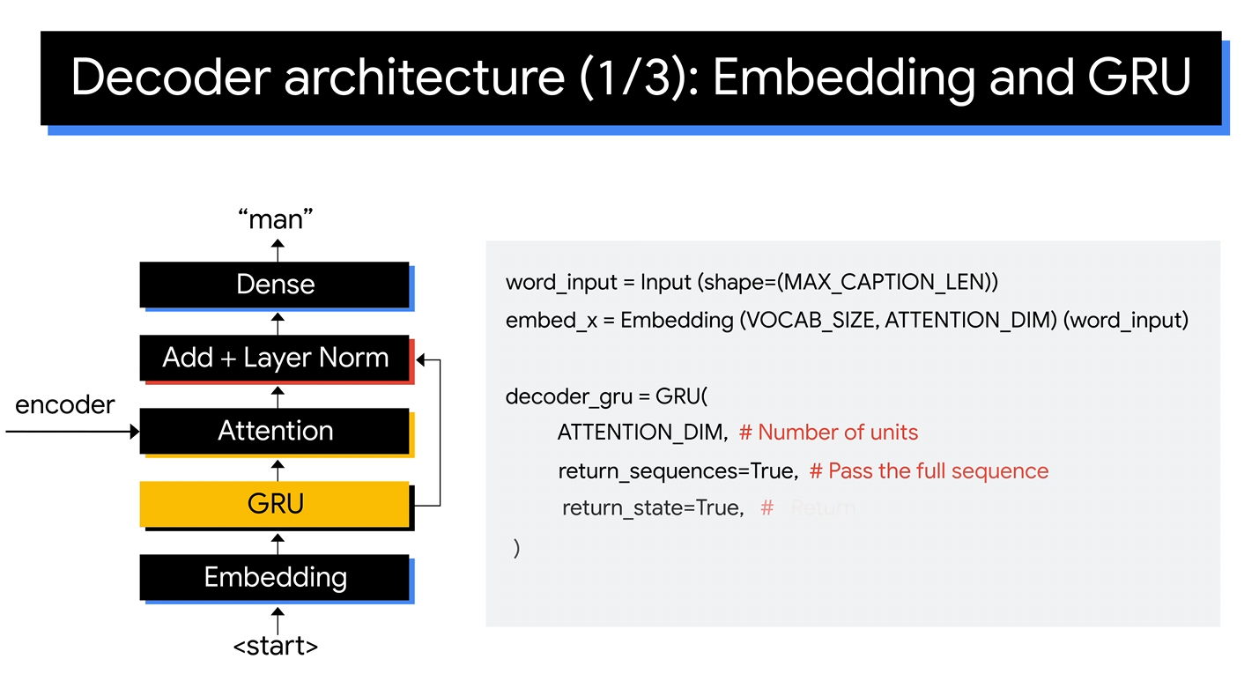
Assigns a probability to every word in the vocabulary
to predict the next token
Refines the output by combining GRU with Attention
Uses the context from the GRU to decide what to focus on in the image
Takes the embedding and combines with others to get overall context
Vectorizes the token
Start token and subsequent token predicted

Slide 14
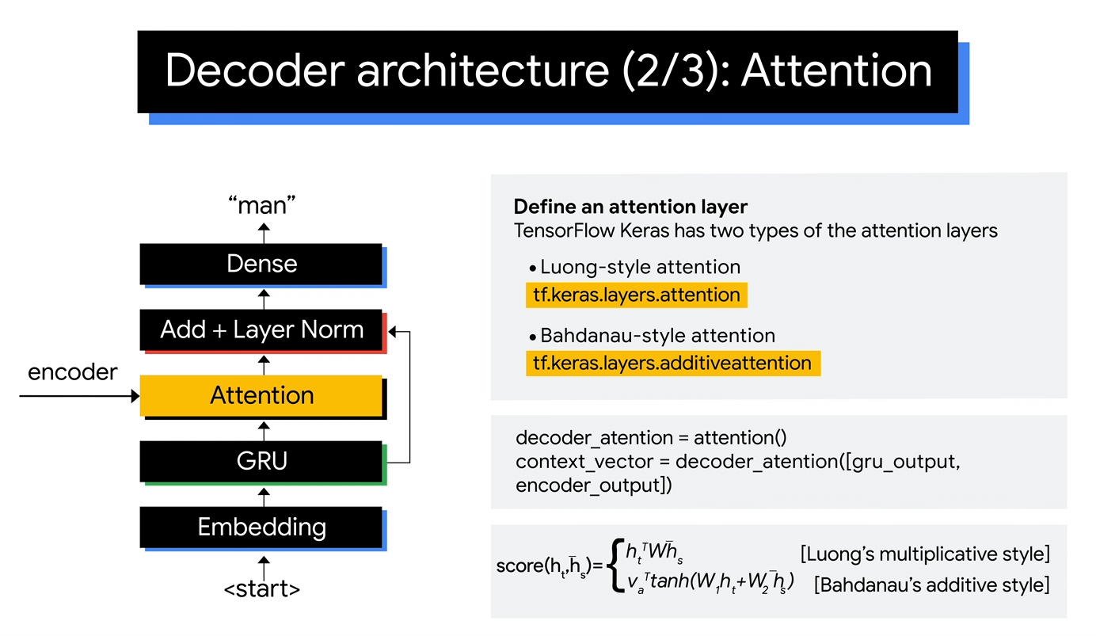

Slide 15
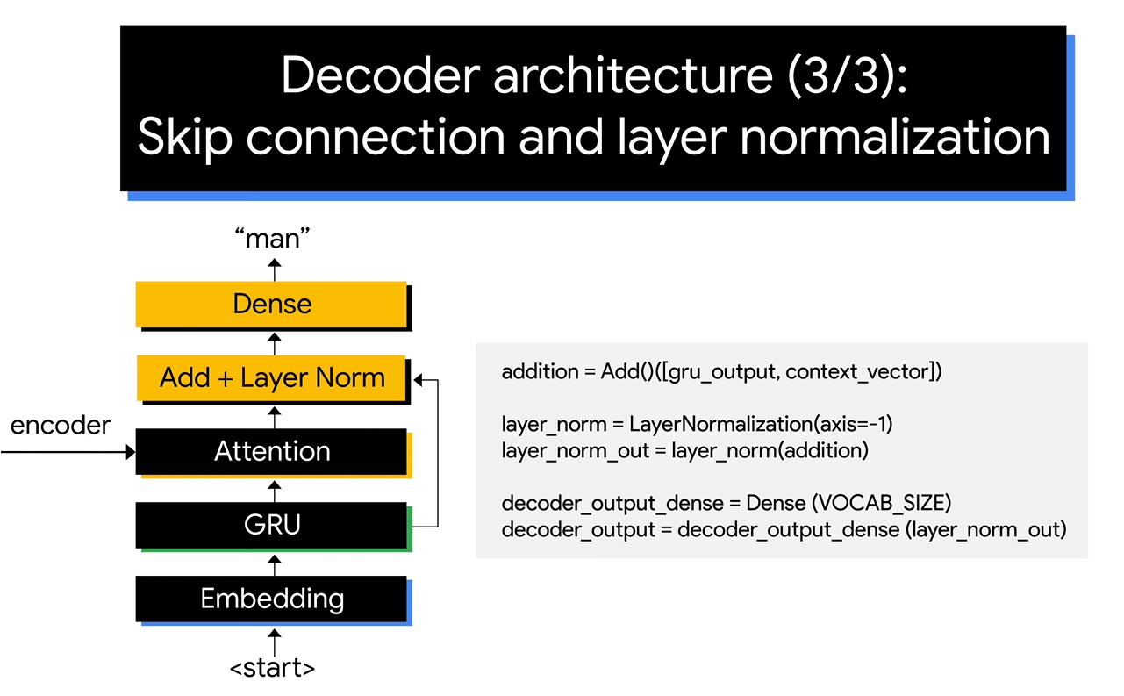

Slide 16
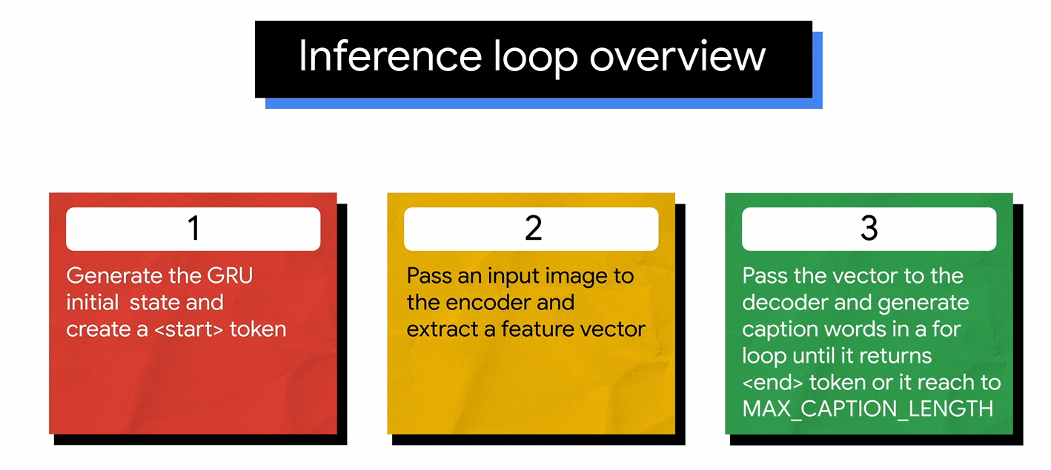

Slide 17
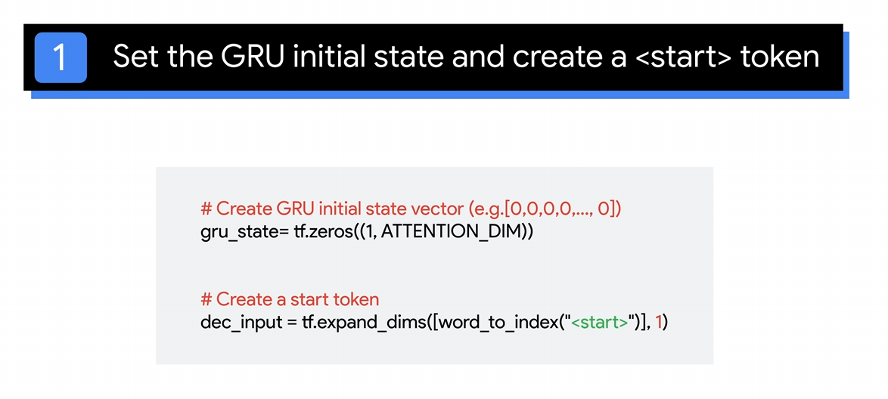

Slide 18
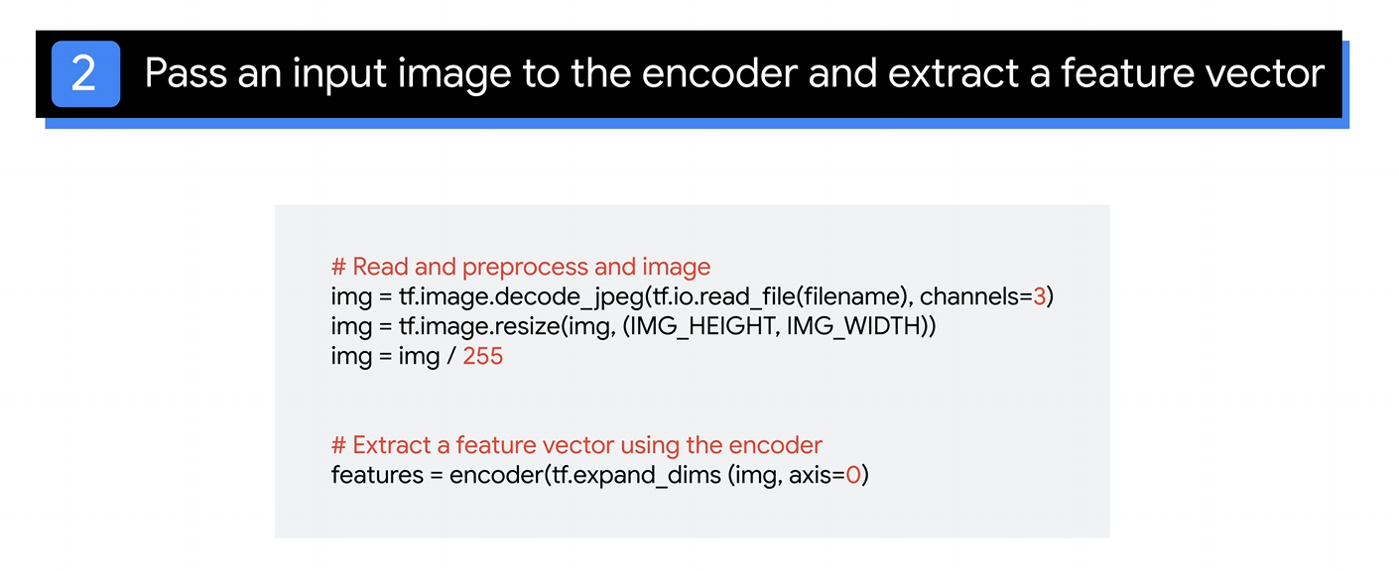

Slide 19
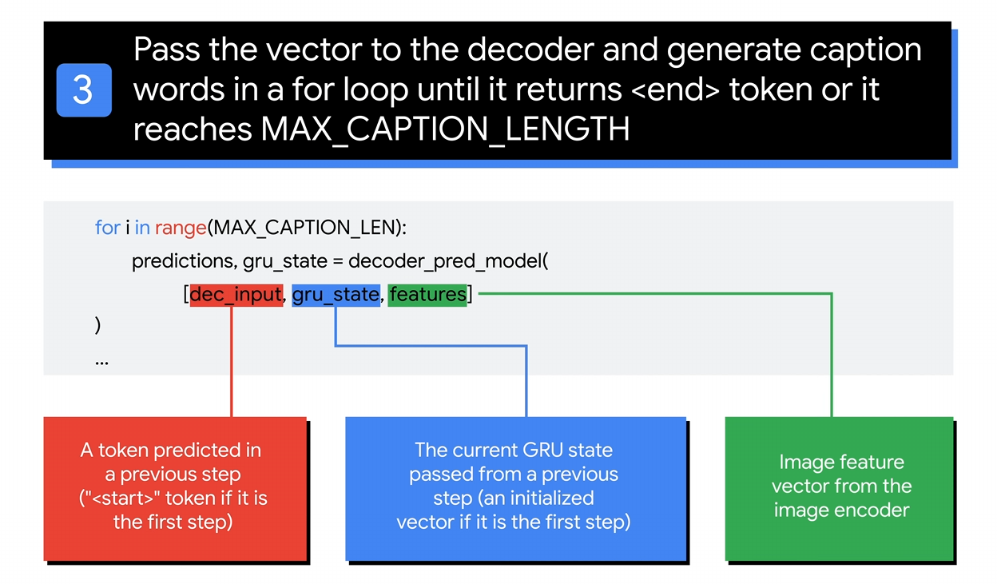

Slide 20
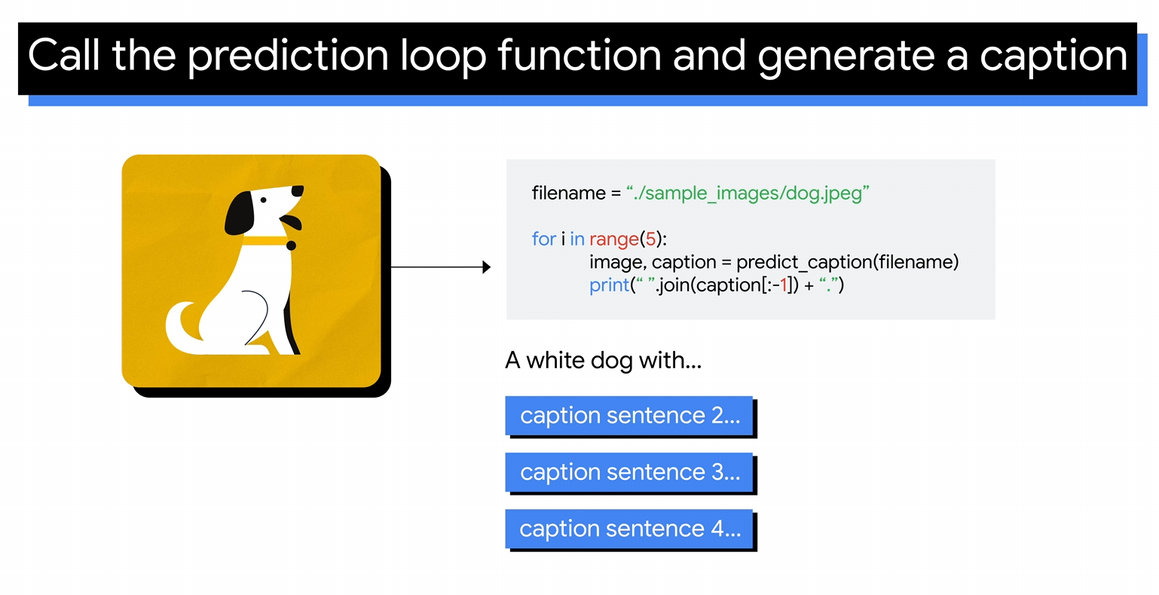

Slide 21
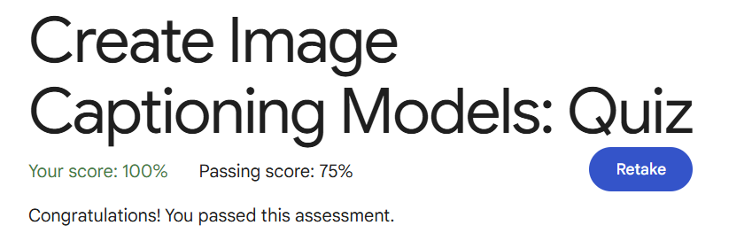
Quiz Answers

Slide 22
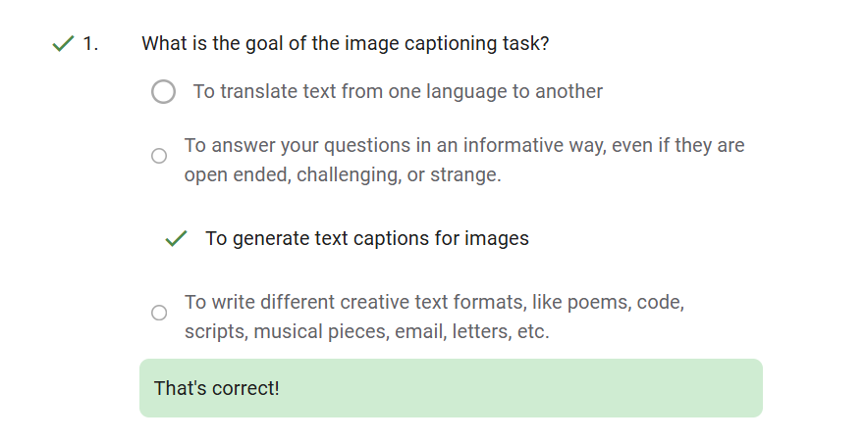

Slide 23
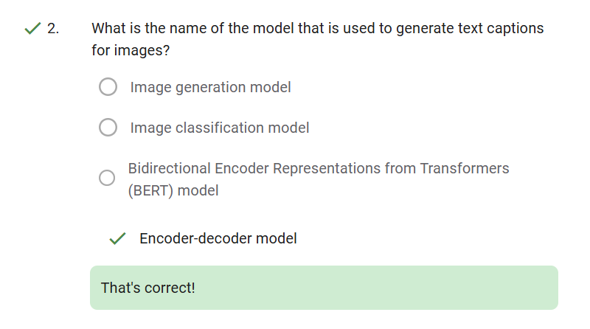

Slide 24
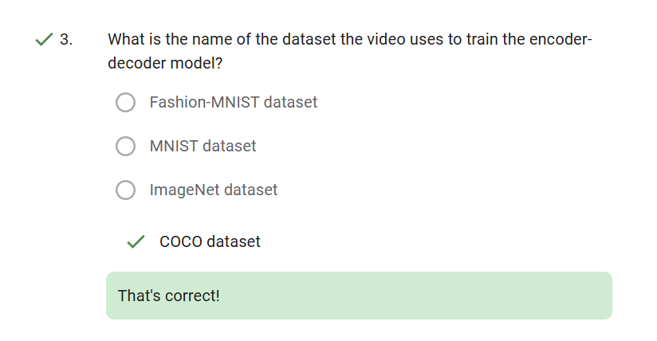

Slide 25
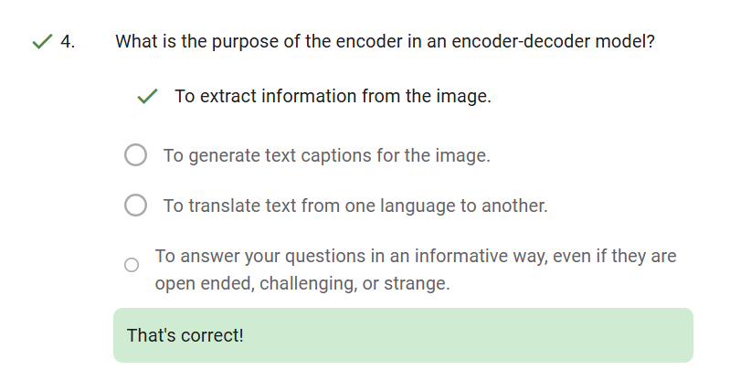

Slide 26
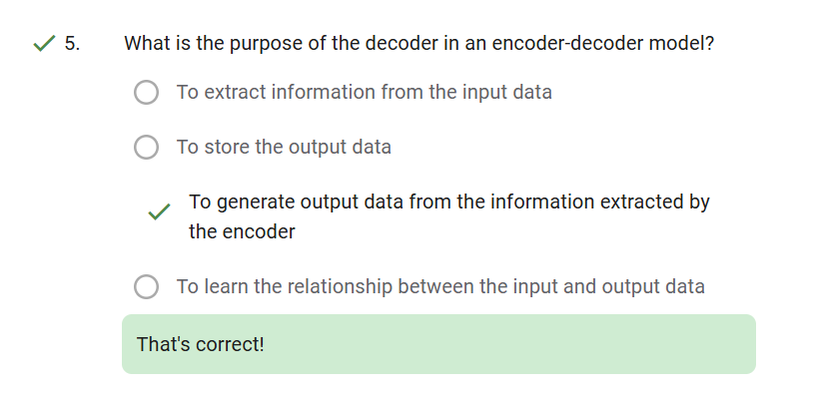

Slide 27
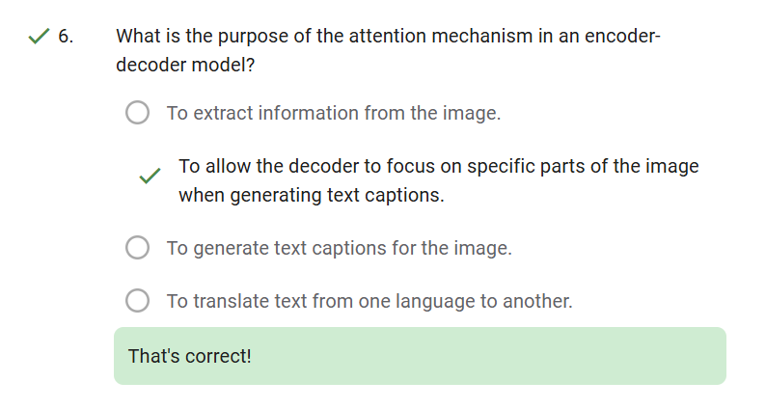

Slide 28


